Slide 1
Control of Distributed Parameter Systems an Engineering Approach – Tutorial
DEMONSTRATIONS

Slide 2
Content of the presentation
DPS Blockset for Simulink
third-party software product of The MathWorks
Some model control problems
DPS Wizard – automatized control loop design tool
Control of temperature fields in metallurgy: shape casting and continuous casting of steel
Interactive Control – service for support the solution of control problems via the Internet

Slide 3
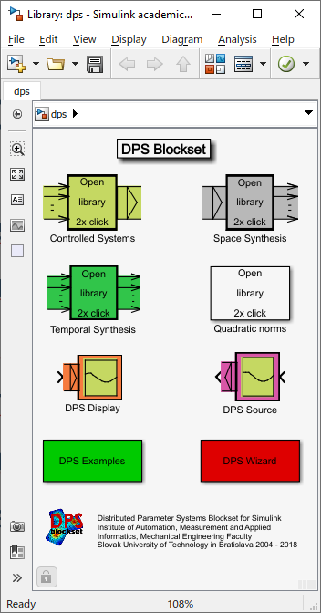
DPS Blockset library
Controlled Systems
Space Synthesis
Temporal Synthesis
DPS Source and DPS Display
DPS Examples
DPS Wizard

Slide 4
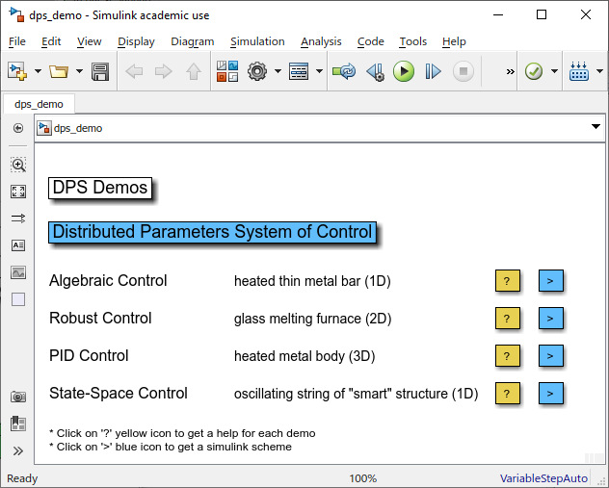
Some model control problems
1D metal bar heating
1D string oscillation
2D glass melting
3D semiproduct heating

Slide 5
1D Control of metal bar heating

Slide 6
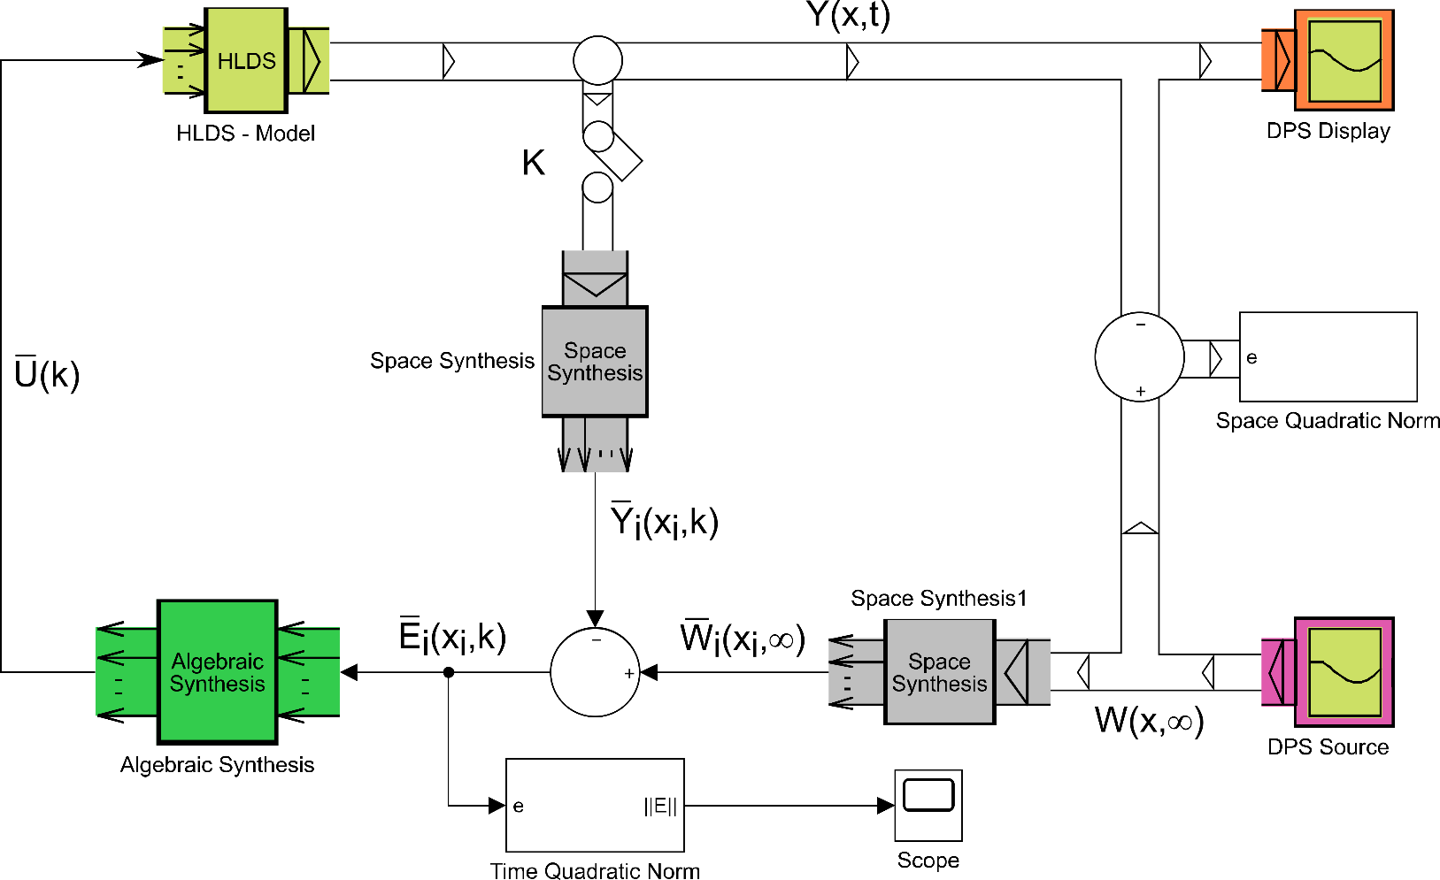
1D metal bar heating control

Slide 8
1D Control of oscillating string

Slide 9
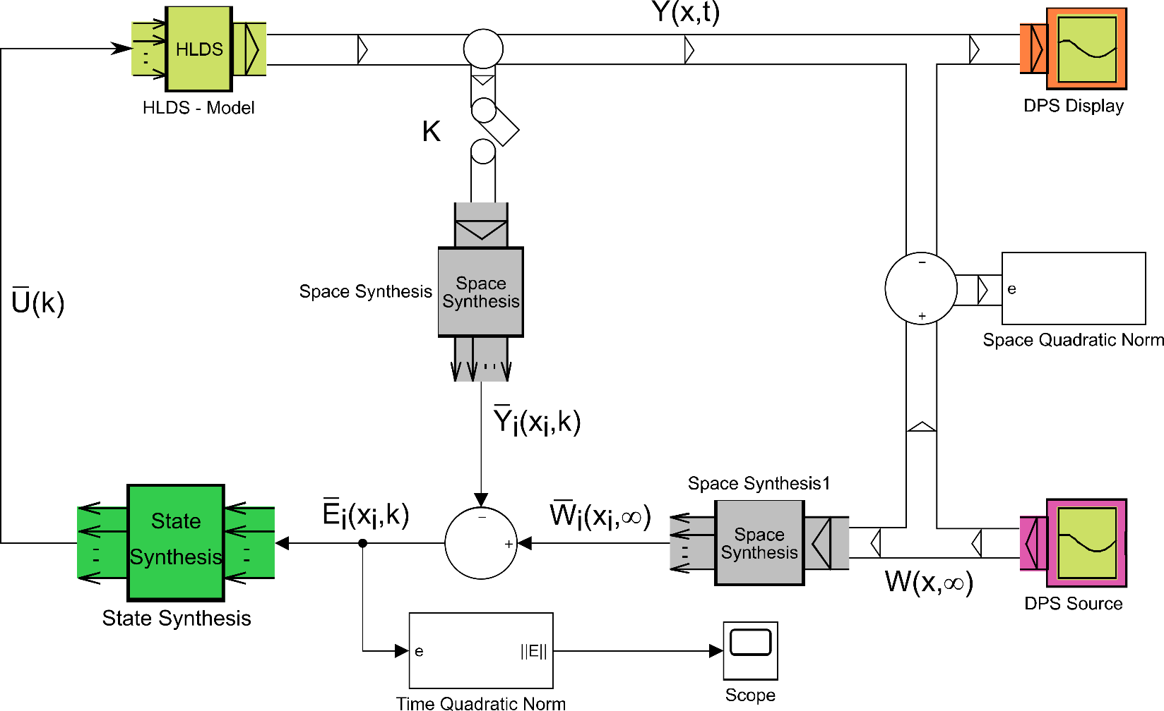
1D string oscillation control

Slide 11
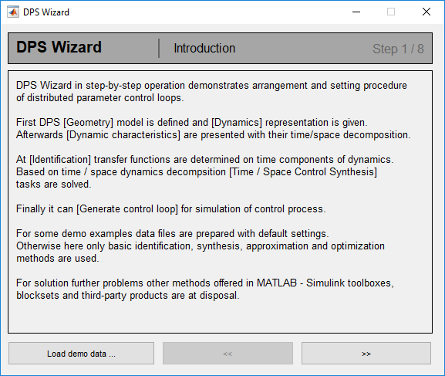
DPS Wizard
Automatized design of control loops
Presentation of default loops
Possibilities for work with custom data

Slide 12
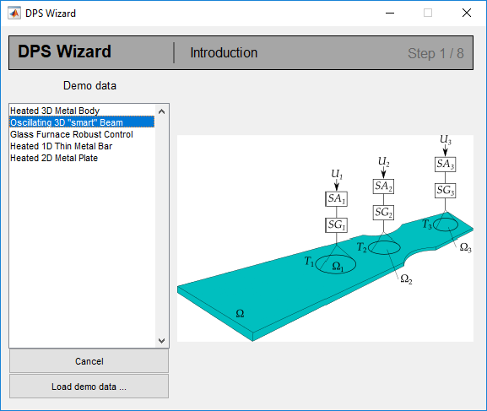
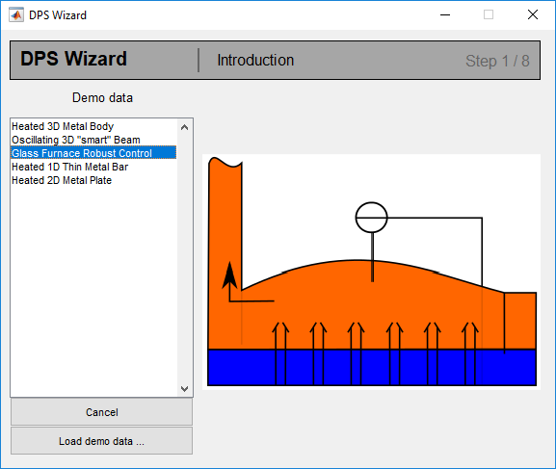
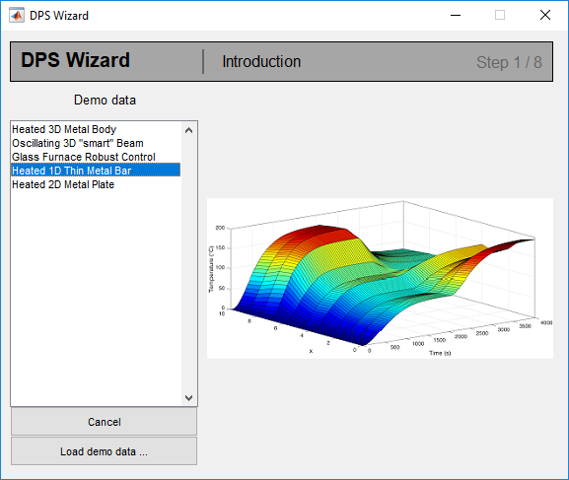
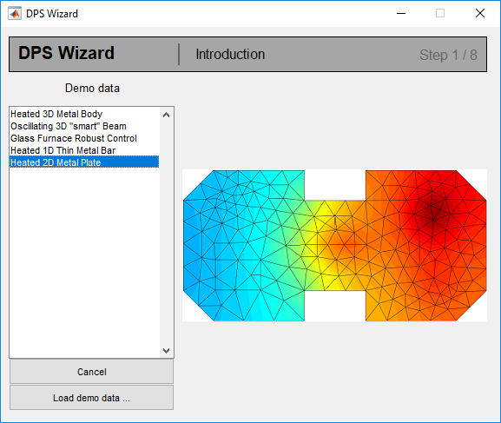
DPS Wizard

Slide 13
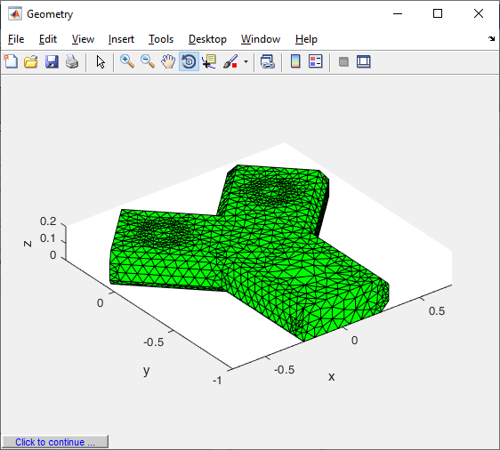
DPS Wizard

Slide 14
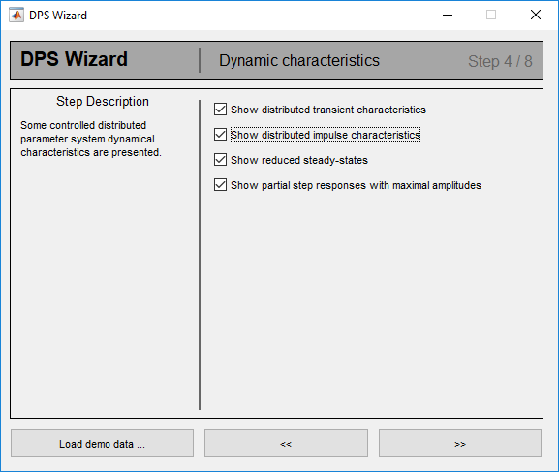
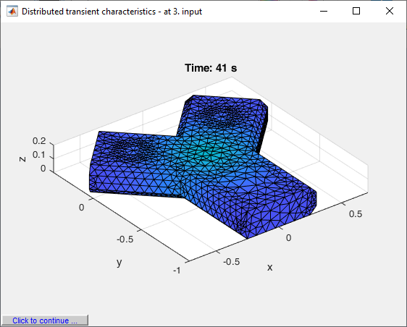
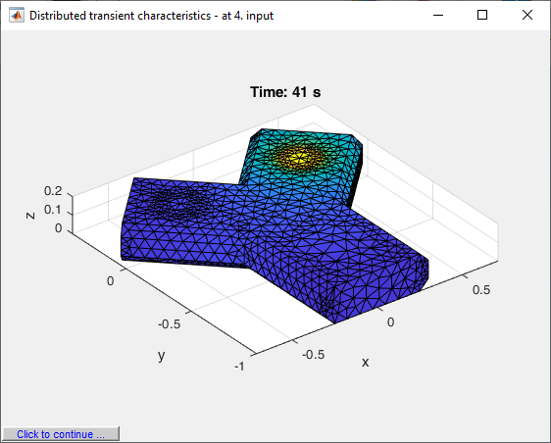
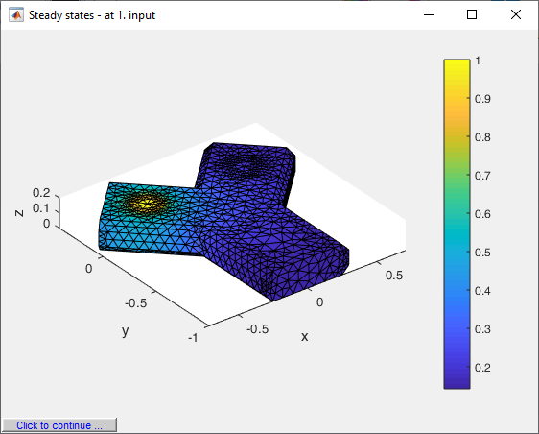
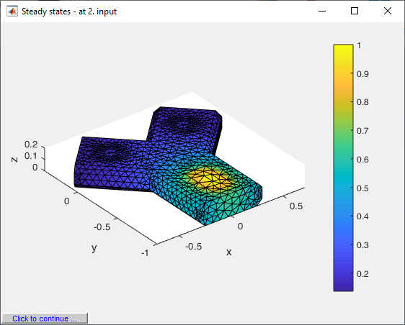
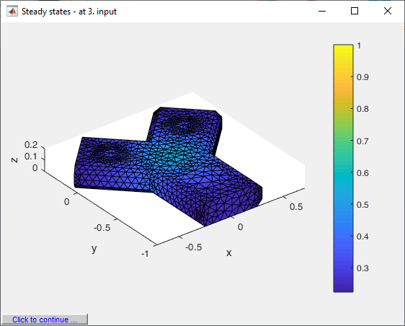
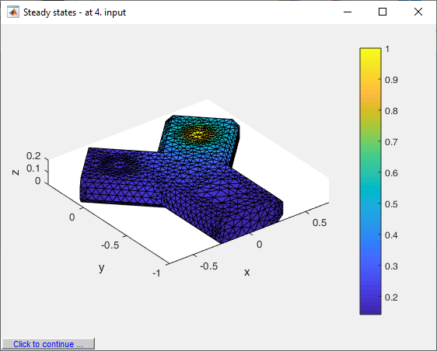
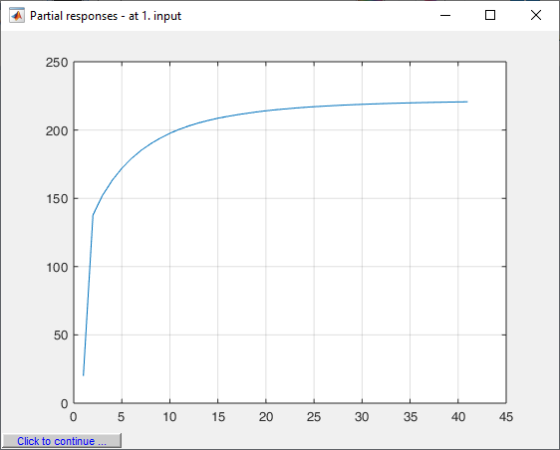
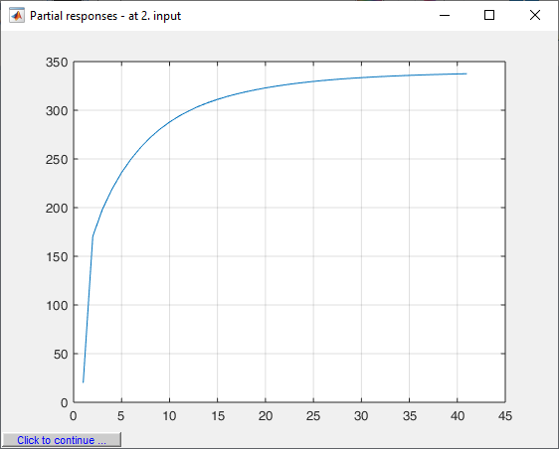
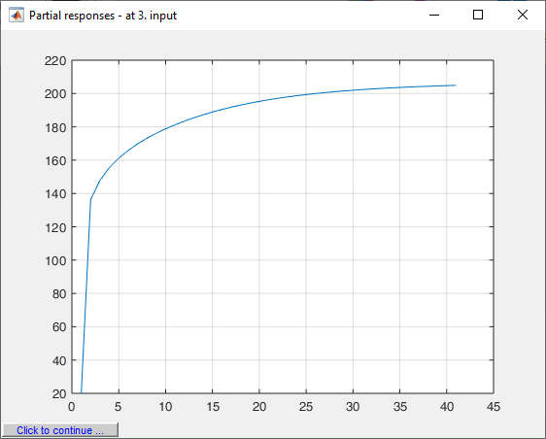
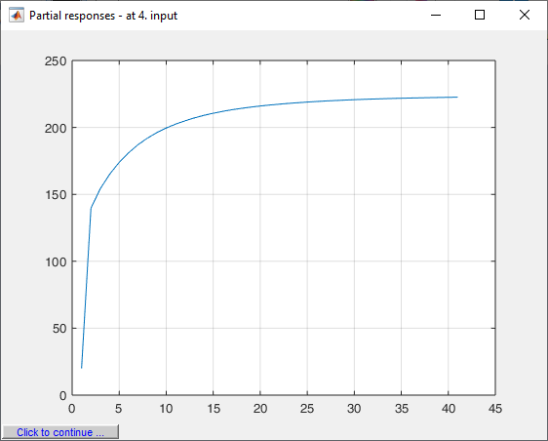
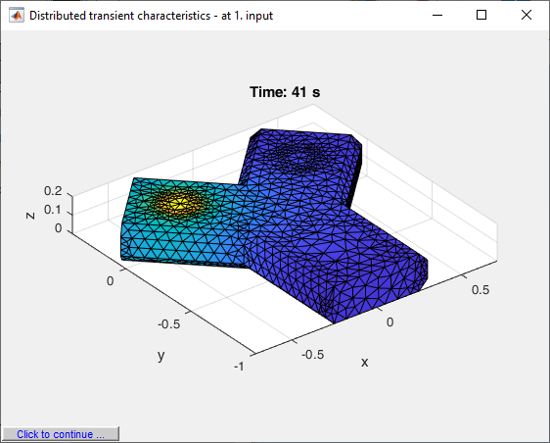
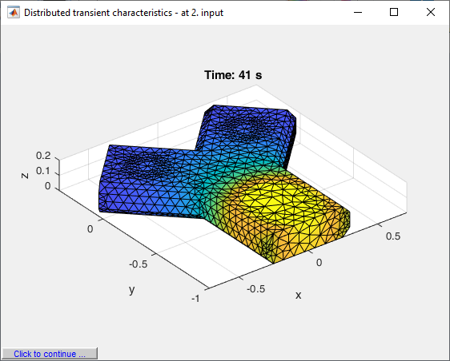
DPS Wizard

Slide 15
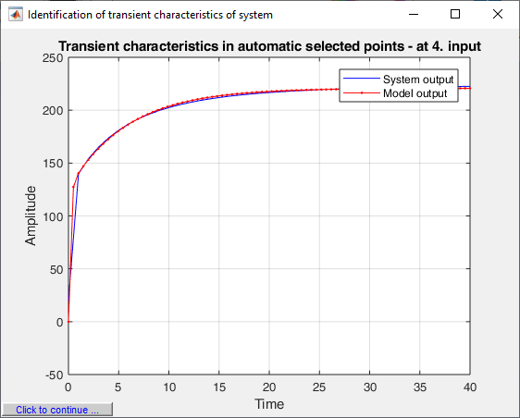
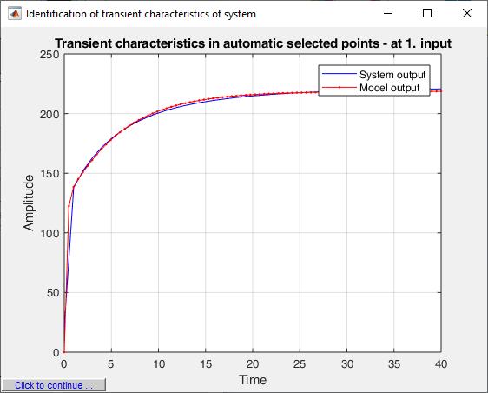
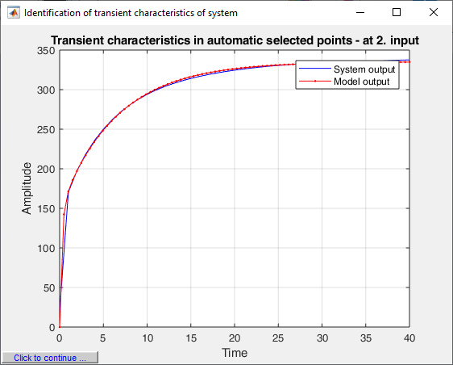
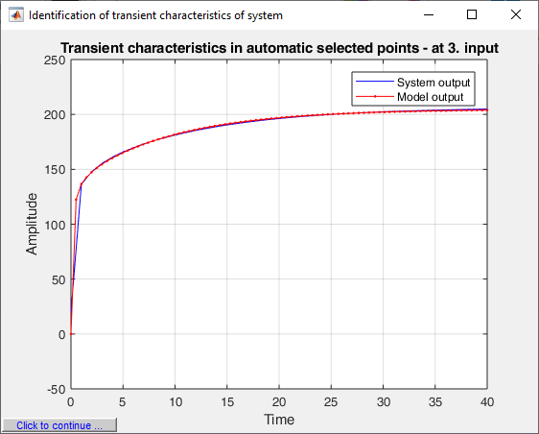
DPS Wizard

Slide 16
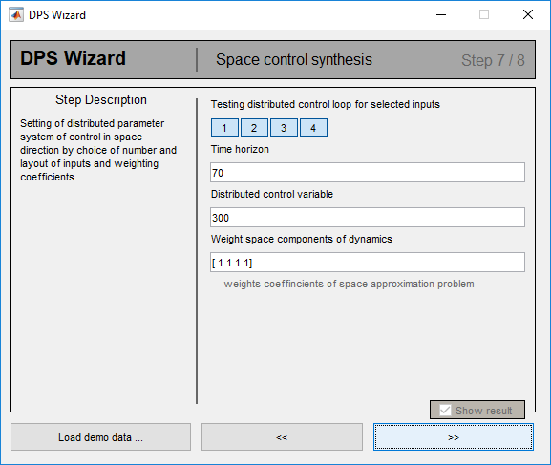
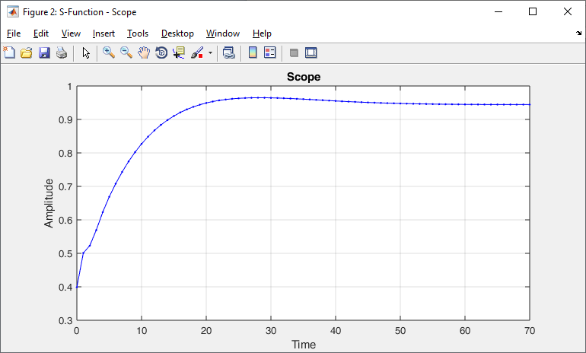
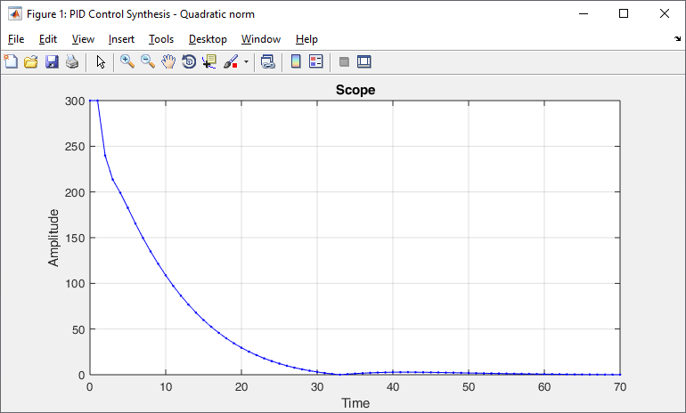
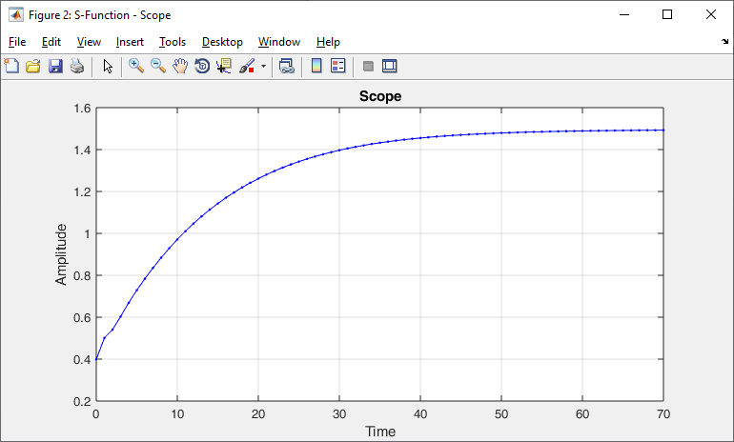
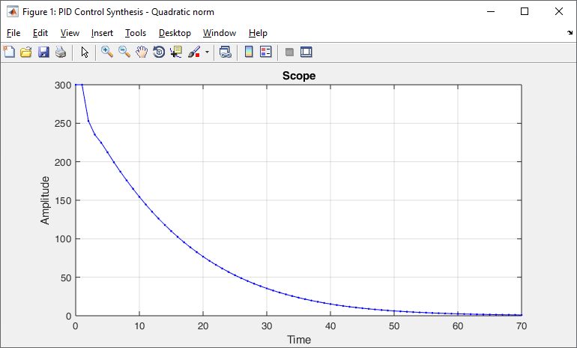
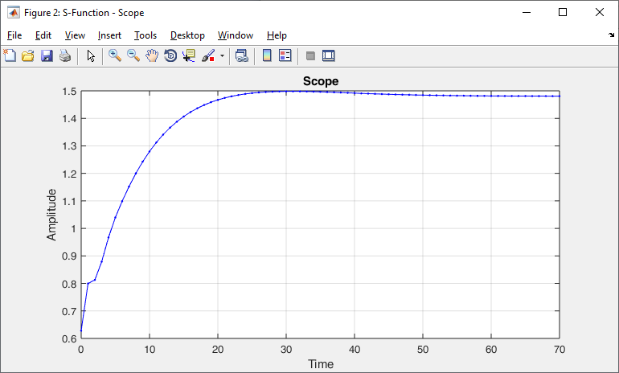
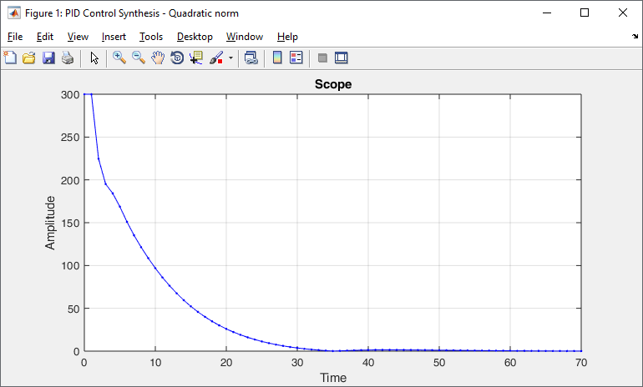
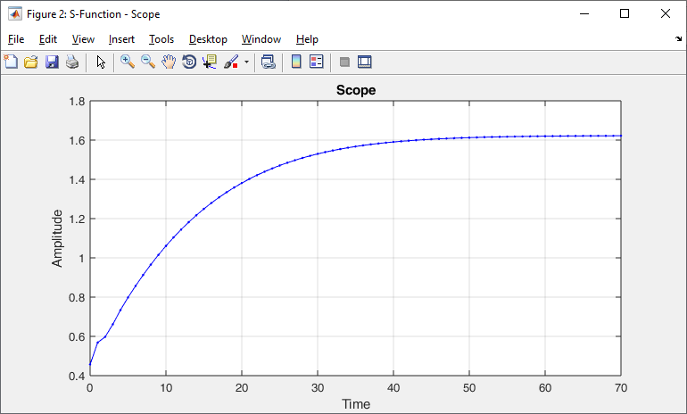
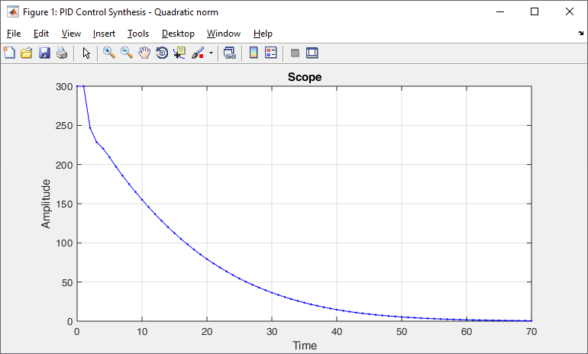
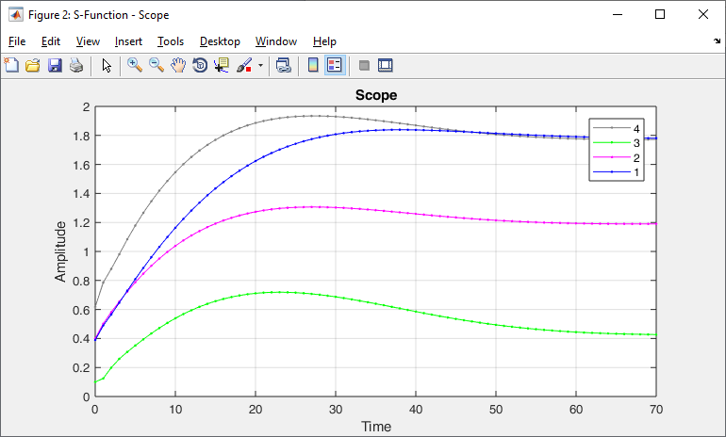
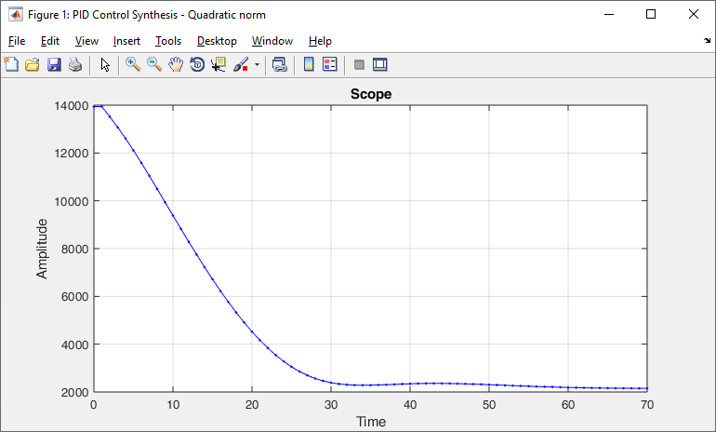
DPS Wizard

Slide 17
DPS Wizard

Slide 19
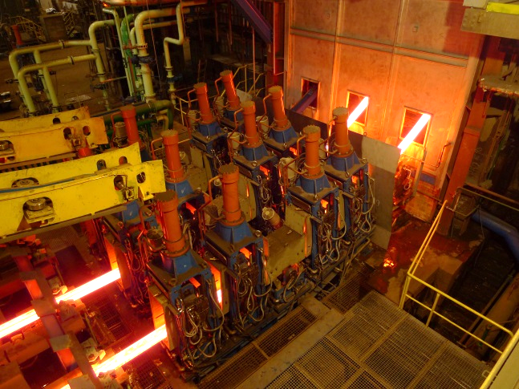
Control of temperature fields in metallurgy Control of secondary cooling in continuous casting of steel

Slide 20
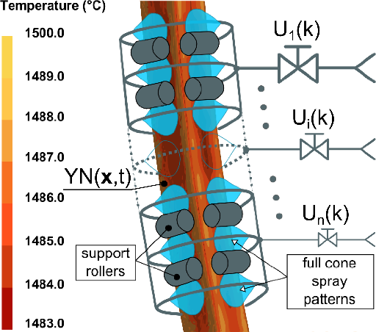
1D temperature field on little radius of the billet is modelled by FEM based numerical model in ProCAST - Control synthesis is solved by software sensor

Slide 21
Control process in surrounding of chosen steady state regime

Slide 22
Control process at abrupt changes of casting speed

Slide 23
Control process at segmentation of nonlinear dynamics of transition between different steady-states

Slide 24
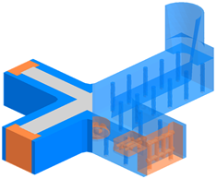
Control of temperature field of experimental casting mold
Actuators: 5 heating zones and 5 chills

Slide 25
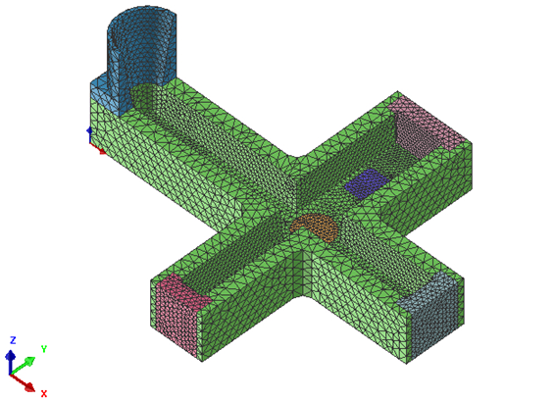
Control synthesis is based on measured (selected) 5 values of temperature field in the 2D bottom region of the active surface of the mold. However temperature field is modelled in points of numerical net

Slide 26
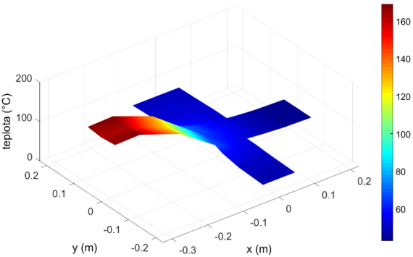
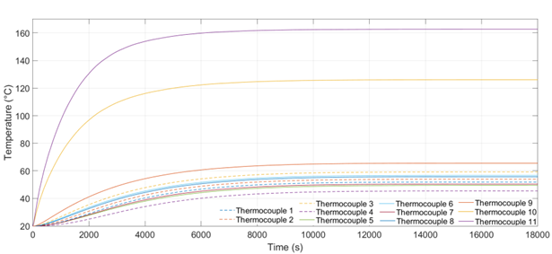
Steady-state profiles at a step change of the input on the 5th ZONE of heating - on the 2D level and on the 3D level along with temperature responses on thermocouples - for calculation space characteristics of dynamics

Slide 27
Temporal dynamical characteristics at sampling period 5 s and optimized distributed reference for preheating

Slide 28
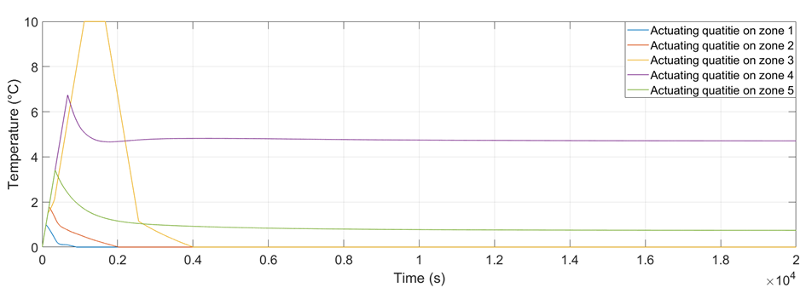
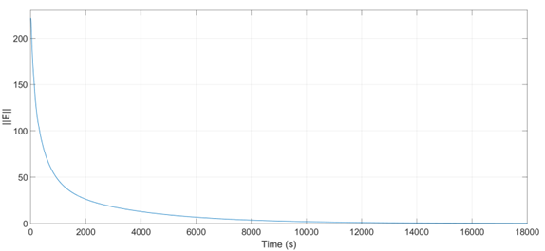
Controlled quantity in new steady-state with actuating quantities and quadratic norm of distributed parameter control deviation

Slide 29
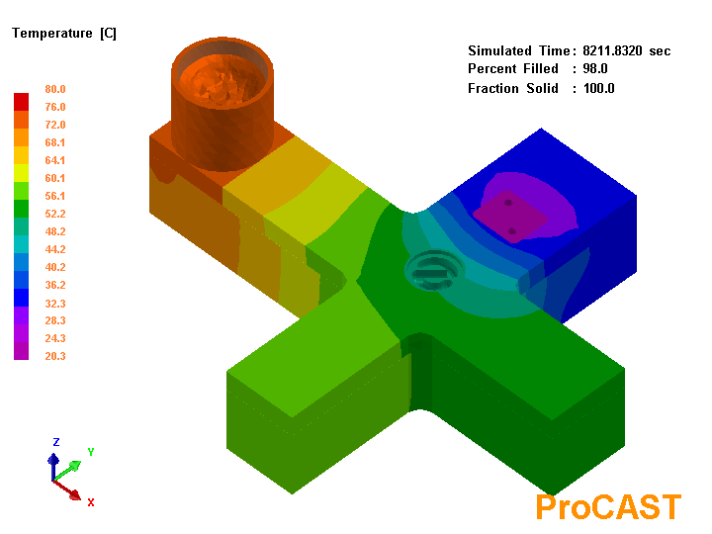
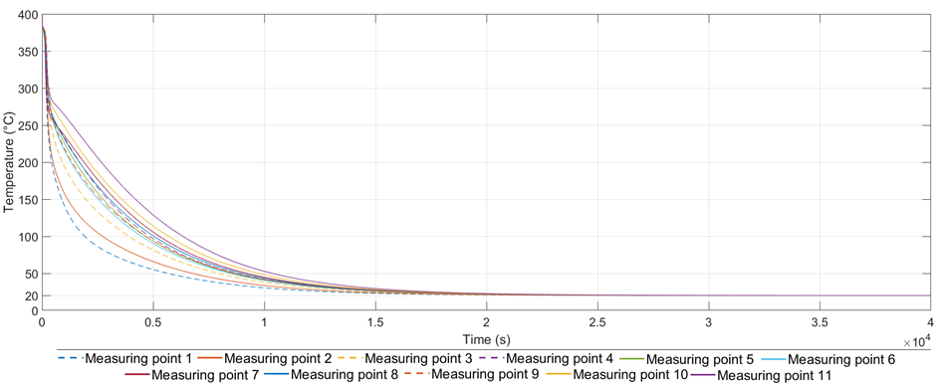
Steady-state profiles at a step change of the input on the 4th Cooling chill - on the 2D level and on the 3D level along with temperature responses on thermocouples - for calculation space characteristics of dynamics

Slide 30
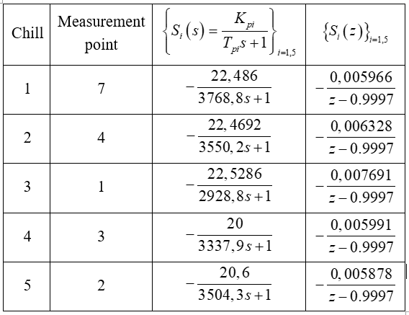
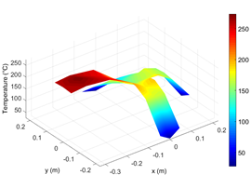
Temporal dynamical characteristics {S_{i}(z)}_{i=1,5} at sampling period 1 s and optimized distributed reference for cooling

Slide 31
Control of cooling process - actuating quantities are flow rates of water through chills
Temperature field in t = 180 s - control action in progress.

Slide 32
End of control action – casting ejection
Temperature field in t = 350 s - end of control action.
Measured temperatures in locations of thermocouples.

Slide 33
Control of preheating process of casting mold

Slide 35
Interactive Control – service for support the solution of control problems via the Internet
Interactive Control via the Internet offers for interested partners the collaboration at the design distributed parameter control loops based on the supplied data and characteristics by DPS Blockset for Simulink – DPS Wizard Consultations and access into the Cloud are provided by DPS Team - contact: gabriel.hulko@stuba.sk

